Slide 1

Topic: First Law of Thermodynamics
Lecture – 4
Disclaimer:
The study materials/presentations are solely meant for academic purposes and they can be reused, reproduced, modified, and distributed by others for academic purposes only with proper acknowledgements.

Slide 2
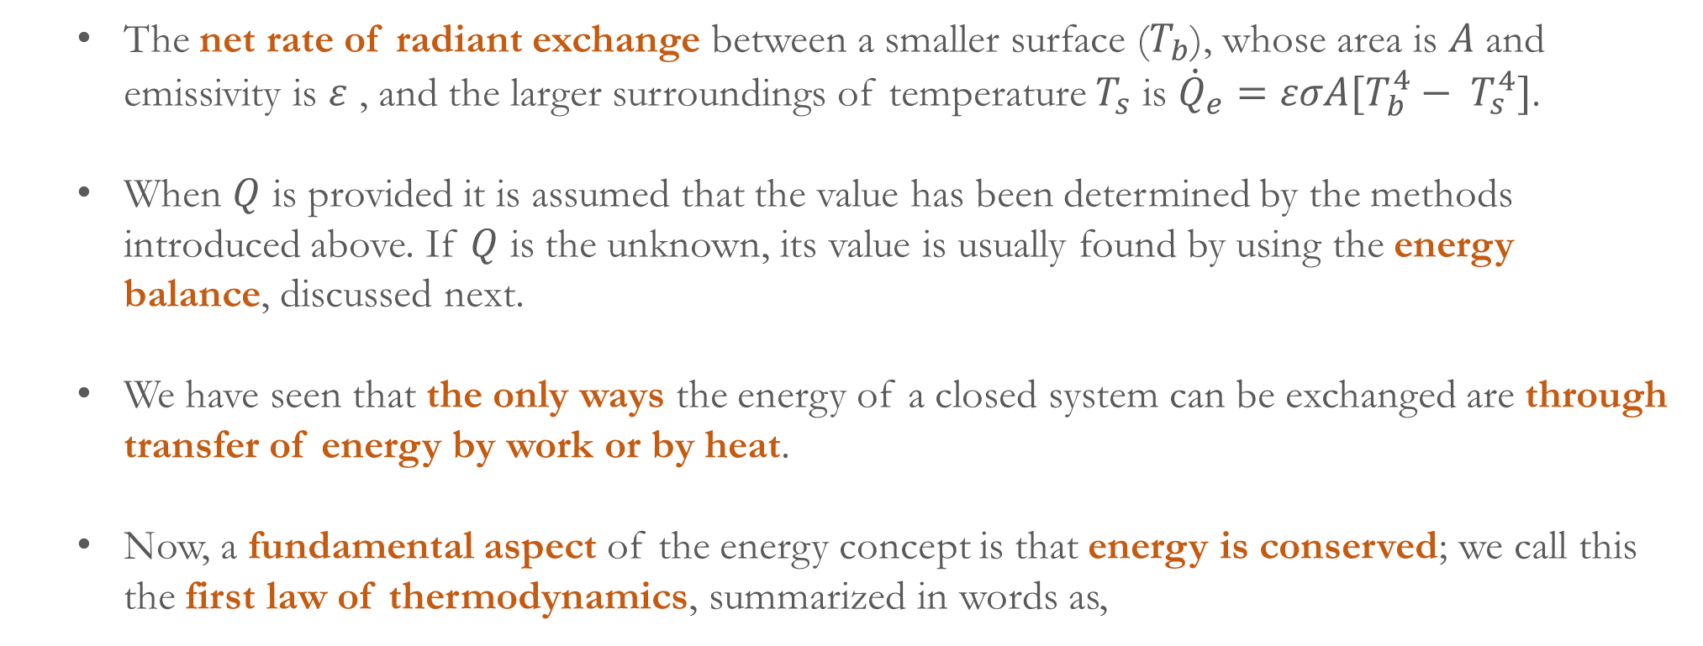
The net rate of radiant exchange between a smaller surface ($T_{b}$), whose area is $A$ and emissivity is $ε$ , and the larger surroundings of temperature $T_{s}$ is ${\dot{Q}}_{e}=εσA[T_{b}^{4}− T_{s}^{4}]$.
When $Q$ is provided it is assumed that the value has been determined by the methods introduced above. If $Q$ is the unknown, its value is usually found by using the energy balance, discussed next.
We have seen that the only ways the energy of a closed system can be exchanged are through transfer of energy by work or by heat.
Now, a fundamental aspect of the energy concept is that energy is conserved; we call this the first law of thermodynamics, summarized in words as,
$$\left[\begin{aligned}Change in the amount \\ of energy contained \\ within a system during \\ some time interval\end{aligned}\right]=\left[\begin{aligned}\begin{aligned}Net amount of energy \\ transferred in across the\end{aligned} \\ system boundary by heat \\ transfer during the time interval\end{aligned}\right]−\left[\begin{aligned}Net amout of energy \\ transferred out accorss the \\ system boundary by work \\ during the time interval\end{aligned}\right]$$

Slide 3
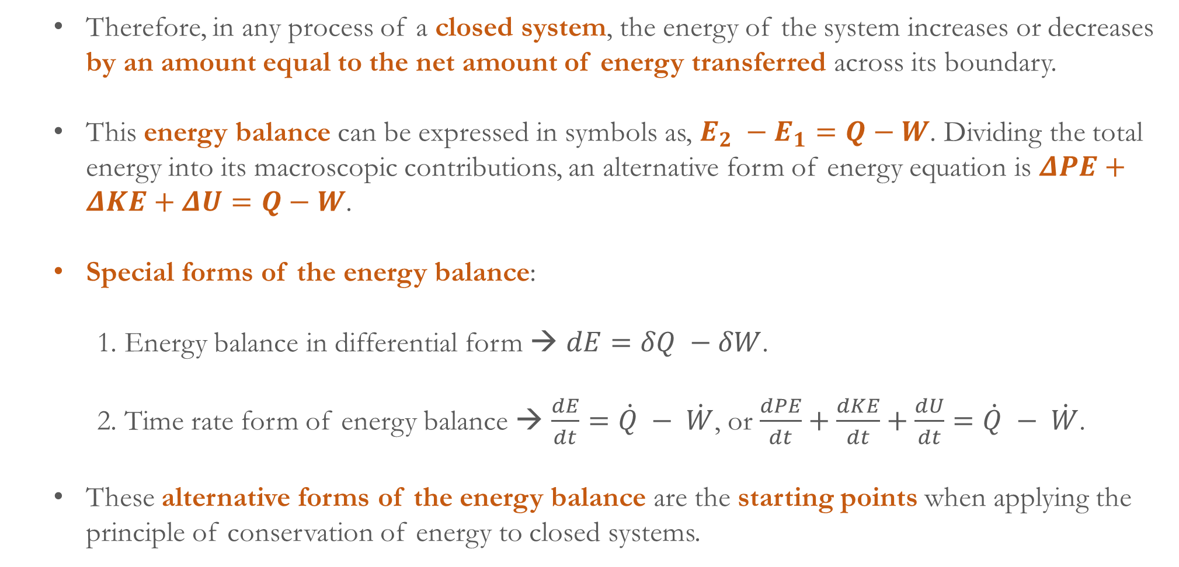
Therefore, in any process of a closed system, the energy of the system increases or decreases by an amount equal to the net amount of energy transferred across its boundary.
This energy balance can be expressed in symbols as, $E_{2} −E_{1}=Q−W$. Dividing the total energy into its macroscopic contributions, an alternative form of energy equation is $ΔPE+ΔKE+ΔU=Q−W$.
Special forms of the energy balance:
  1. Energy balance in differential form → $dE=δQ −δW$.
  2. Time rate form of energy balance → $\frac{dE}{dt}=\dot{Q} − \dot{W}$, or $\frac{dPE}{dt}+\frac{dKE}{dt}+\frac{dU}{dt}=\dot{Q} − \dot{W}$.
These alternative forms of the energy balance are the starting points when applying the principle of conservation of energy to closed systems.

Slide 4
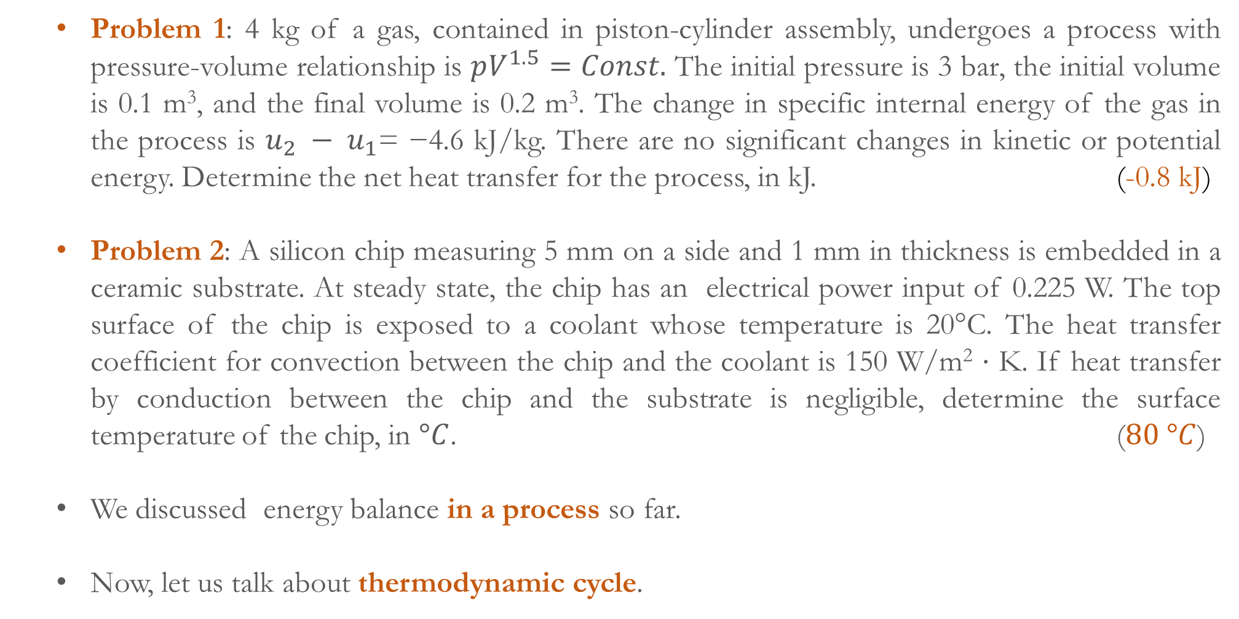
Problem 1: 4 kg of a gas, contained in piston-cylinder assembly, undergoes a process with pressure-volume relationship is $pV^{1.5}=Const.$ The initial pressure is 3 bar, the initial volume is 0.1 m³, and the final volume is 0.2 m³. The change in specific internal energy of the gas in the process is $u_{2} − u_{1}$= −4.6 kJ/kg. There are no significant changes in kinetic or potential energy. Determine the net heat transfer for the process, in kJ. (-0.8 kJ)
Problem 2: A silicon chip measuring 5 mm on a side and 1 mm in thickness is embedded in a ceramic substrate. At steady state, the chip has an electrical power input of 0.225 W. The top surface of the chip is exposed to a coolant whose temperature is 20°C. The heat transfer coefficient for convection between the chip and the coolant is 150 W/m² ⋅ K. If heat transfer by conduction between the chip and the substrate is negligible, determine the surface temperature of the chip, in $°C$. ($80 °C$)
We discussed energy balance in a process so far.
Now, let us talk about thermodynamic cycle.

Slide 5
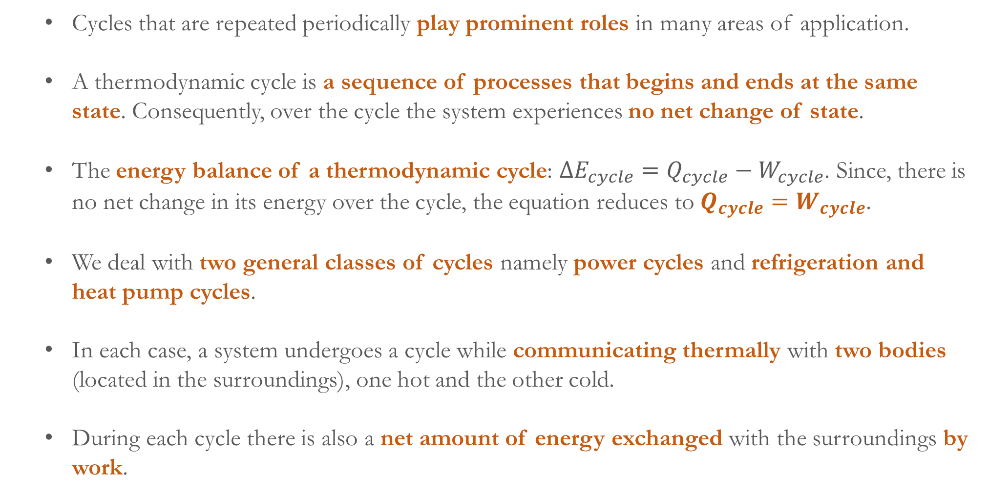
Cycles that are repeated periodically play prominent roles in many areas of application.
A thermodynamic cycle is a sequence of processes that begins and ends at the same state. Consequently, over the cycle the system experiences no net change of state.
The energy balance of a thermodynamic cycle: $ΔE_{cycle}=Q_{cycle}−W_{cycle}$. Since, there is no net change in its energy over the cycle, the equation reduces to $Q_{cycle}=W_{cycle}$.
We deal with two general classes of cycles namely power cycles and refrigeration and heat pump cycles.
In each case, a system undergoes a cycle while communicating thermally with two bodies (located in the surroundings), one hot and the other cold.
During each cycle there is also a net amount of energy exchanged with the surroundings by work.

Slide 6
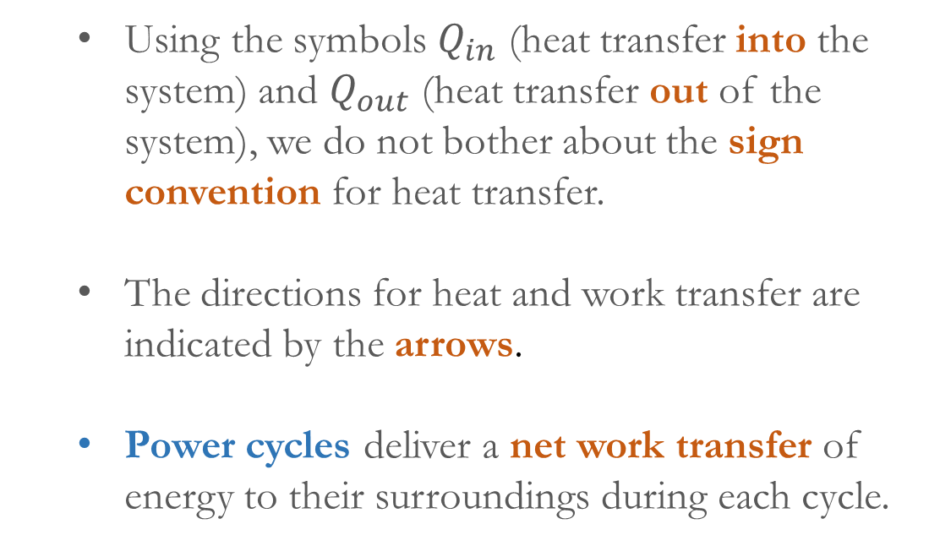
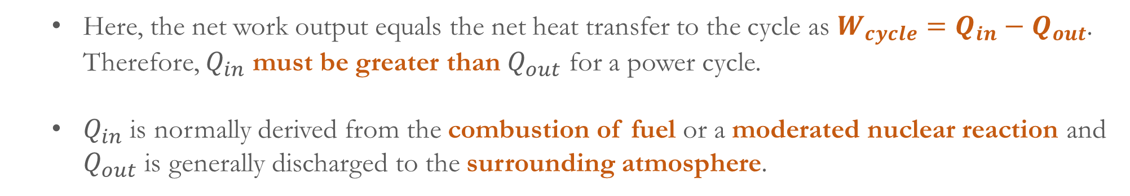
Using the symbols $Q_{in}$ (heat transfer into the system) and $Q_{out}$ (heat transfer out of the system), we do not bother about the sign convention for heat transfer.
The directions for heat and work transfer are indicated by the arrows.
Power cycles deliver a net work transfer of energy to their surroundings during each cycle.
Power cycles
Refrigeration and heat pump cycles
Here, the net work output equals the net heat transfer to the cycle as $W_{cycle}=Q_{in}−Q_{out}$. Therefore, $Q_{in}$ must be greater than $Q_{out}$ for a power cycle.
$Q_{in}$ is normally derived from the combustion of fuel or a moderated nuclear reaction and $Q_{out}$ is generally discharged to the surrounding atmosphere.

Slide 7
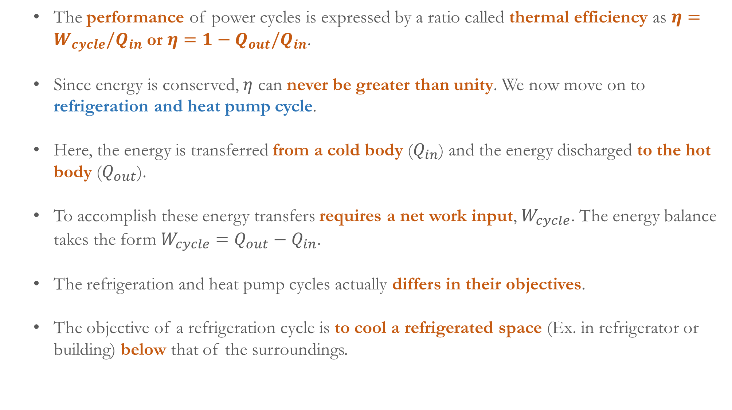
The performance of power cycles is expressed by a ratio called thermal efficiency as $η=W_{cycle}/Q_{in}$ or $η=1−Q_{out}/Q_{in}$.
Since energy is conserved, $η$ can never be greater than unity. We now move on to refrigeration and heat pump cycle.
Here, the energy is transferred from a cold body ($Q_{in}$) and the energy discharged to the hot body ($Q_{out}$).
To accomplish these energy transfers requires a net work input, $W_{cycle}$. The energy balance takes the form $W_{cycle}=Q_{out}−Q_{in}$.
The refrigeration and heat pump cycles actually differs in their objectives.
The objective of a refrigeration cycle is to cool a refrigerated space (Ex. in refrigerator or building) below that of the surroundings.

Slide 8
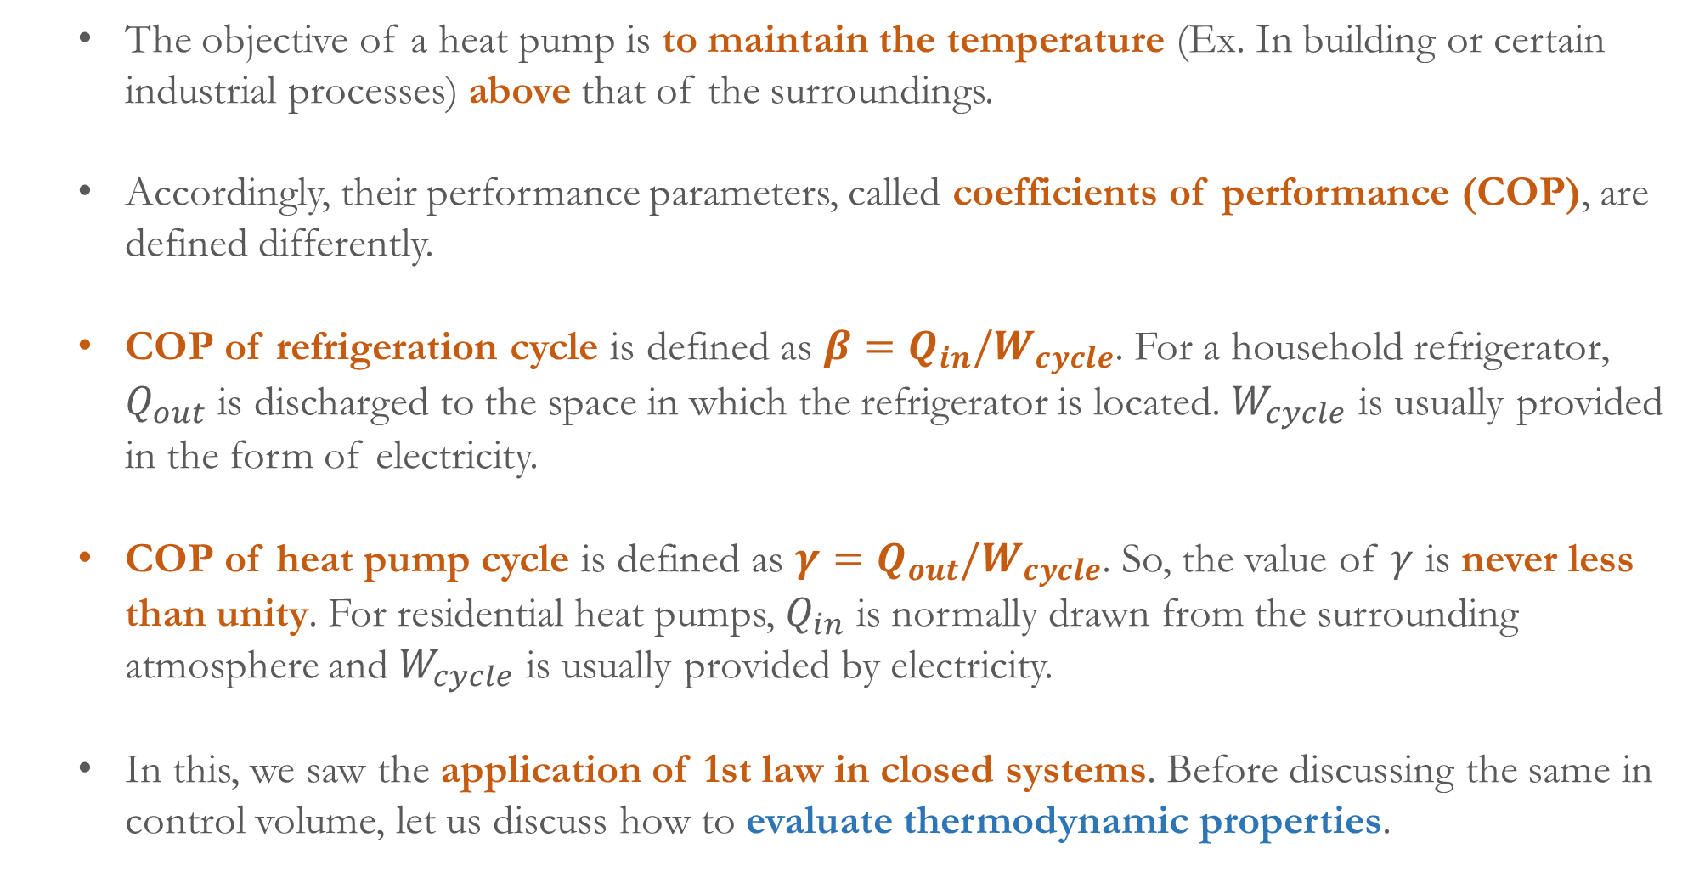
The objective of a heat pump is to maintain the temperature (Ex. In building or certain industrial processes) above that of the surroundings.
Accordingly, their performance parameters, called coefficients of performance (COP), are defined differently.
COP of refrigeration cycle is defined as $β=Q_{in}/W_{cycle}$. For a household refrigerator, $Q_{out}$ is discharged to the space in which the refrigerator is located. $W_{cycle}$ is usually provided in the form of electricity.
COP of heat pump cycle is defined as $γ=Q_{out}/W_{cycle}$. So, the value of $γ$ is never less than unity. For residential heat pumps, $Q_{in}$ is normally drawn from the surrounding atmosphere and $W_{cycle}$ is usually provided by electricity.
In this, we saw the application of 1st law in closed systems. Before discussing the same in control volume, let us discuss how to evaluate thermodynamic properties.

Slide 9
Application of energy balance equation we developed so far requires knowledge of the properties of the system for solving problems.
Before discussing how to evaluate thermodynamic properties, we introduce the concept of phase and pure substance.
Phase refers to a quantity of matter that is homogeneous throughout in both chemical composition and physical structure (all gas, all liquid, etc.).
Example:
  Mixture of liquid water and water vapor contains two phases (inhomogeneous in physical structure)
  Mixture of alcohol and water (miscible) can form a single liquid phase (homogeneous in chemical composition).

Slide 10
  Mixture of oil and water (immiscible) form two liquid phase (inhomogeneous in chemical composition).
  Pure substance refers to a quantity of matter that is homogeneous throughout in chemical composition.
  Example:
    Mixture of liquid water and water vapor can be considered as pure substance (homogeneous chemical composition)
    A uniform mixture of gases (air) can be considered as pure substance (homogeneous chemical composition).
    However, if air starts getting liquefied, the mixture cannot be considered as pure substance (composition of liquefied air is different).

Slide 11
  Fixing the state:
  A state of a system at equilibrium is described by the values of a set of intensive properties.
  All the properties are not independent. Therefore, a subset of all properties is sufficient to describe a state, called state principle/state postulate.
  The systems in the absence of electrical, magnetic, gravitational, motion, and surface tension effects with pure substances, are called simple compressible systems.
  For such systems, specification of the values for any two independent intensive thermodynamic properties will fix the values of all other properties.
  Example: For a gas, temperature (𝑇) and specific volume (𝑣) can be two independent properties. Therefore, pressure, 𝑝 = 𝑝(𝑇,𝑣) and specific internal energy, 𝑢 = 𝑢(𝑇,𝑣).

Slide 12
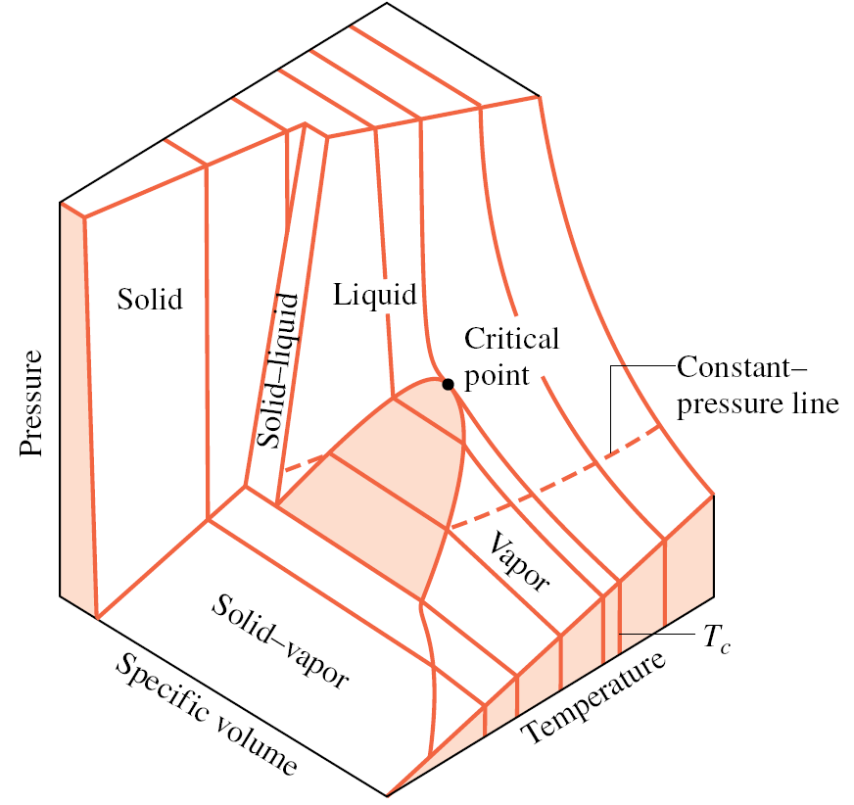
  We discuss the evaluation of thermodynamic properties of simple compressible systems consisting of a pure substance.
  Properties of pure, simple compressible substance:
  The temperature (𝑇) and specific volume (𝑣) can be regarded as independent and pressure (𝑝) is determined as a function of these two as 𝑝 = 𝑝(𝑇,𝑣).
  This is a well known 𝑝−𝑣−𝑇 relation, and the graph of such function is a surface, known as 𝑝−𝑣−𝑇 surface (shown below).
For the substance that expands on freezing, e.g. water
For the substance that contracts on freezing, e.g. most substances

Slide 13
  In the single-phase regions (labelled as solid, liquid and vapor), the state is fixed by any two of the properties: 𝑝, 𝑣, and 𝑇, since all of these are independent when there is a single phase present.
  There are two-phase regions where two phases exist in equilibrium: liquid–vapor, solid–liquid, and solid–vapor, during changes in phase such as vaporization, melting, and sublimation, respectively.
  In two phase region, pressure and temperature are not independent. Therefore, the state can be fixed by specific volume and either pressure or temperature.
  All three phases can exist in equilibrium along the line labeled triple line.
  A state at which a phase change begins or ends is called a saturation state.
  The dome-shaped region composed of the liquid–vapor states is called the vapor dome.

Slide 14
  The lines bordering the vapor dome are called saturated liquid and saturated vapor lines.
  At the top of the dome, where the saturated liquid and saturated vapor lines meet, is the critical point.
  The temperature, pressure and specific volume at the critical point are known as critical temperature, critical pressure and critical specific volume.
  It is often more convenient to work with two-dimensional projections of the surface.
  When the 𝑝–𝜐–𝑇 surface is projected onto the pressure–temperature plane, the property diagram is known as a phase diagram.
  In this, the two-phase regions reduce to lines. Each point on these lines represents all two-phase mixtures at that particular temperature and pressure.

Slide 15
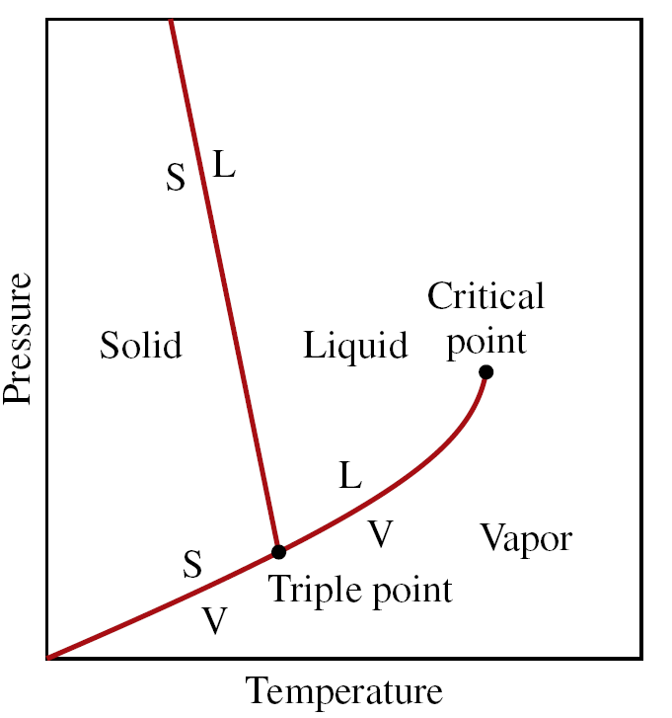
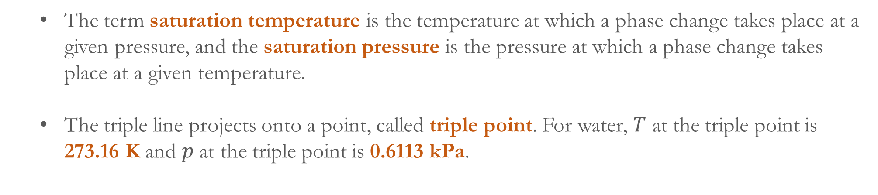
For the substance that expands on freezing, e.g. water
For the substance that contracts on freezing, e.g. most substances
  The term saturation temperature is the temperature at which a phase change takes place at a given pressure, and the saturation pressure is the pressure at which a phase change takes place at a given temperature.
  The triple line projects onto a point, called triple point. For water, $T$ at the triple point is 273.16 K and $p$ at the triple point is 0.6113 kPa.

Slide 16
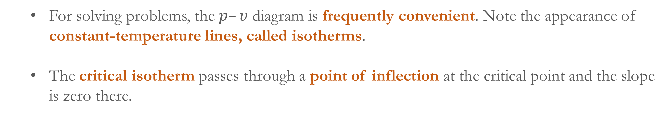
  Projecting the 𝑝–𝜐–𝑇 surface onto the pressure–specific volume plane results in a 𝑝–𝜐 diagram (below).
For the substance that expands on freezing, e.g. water
For the substance that contracts on freezing, e.g. most substances
  For solving problems, the $p–υ$ diagram is frequently convenient. Note the appearance of constant-temperature lines, called isotherms.
  The critical isotherm passes through a point of inflection at the critical point and the slope is zero there.

Slide 17
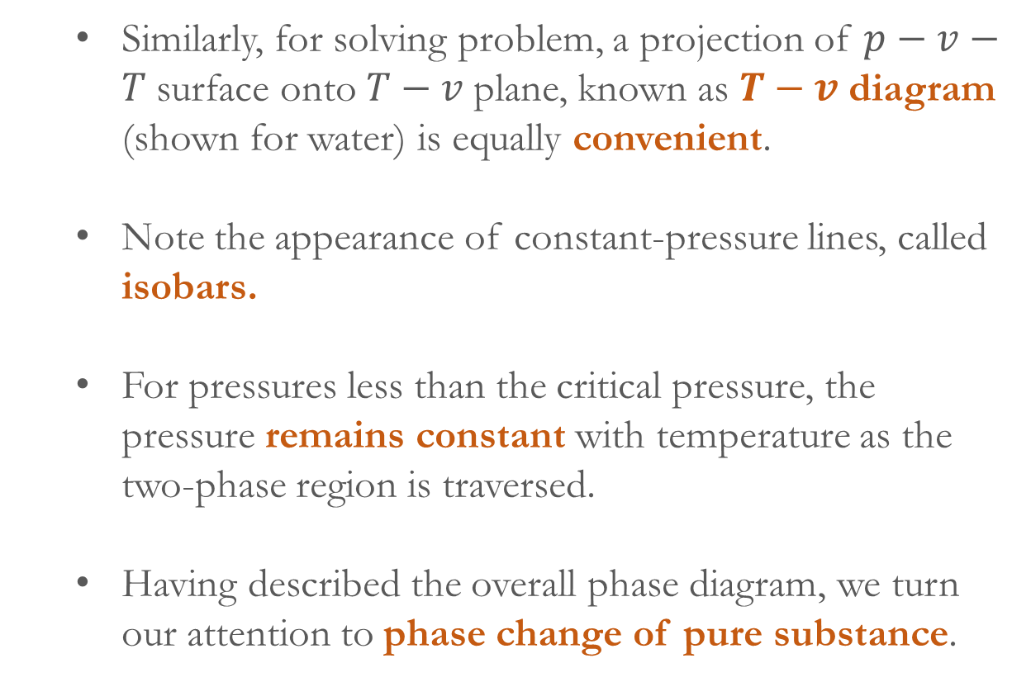
  Similarly, for solving problem, a projection of $p−v−T$surface onto $T−v$plane, known as $T−v$diagram (shown for water) is equally convenient.
  Note the appearance of constant-pressure lines, called isobars.
  For pressures less than the critical pressure, the pressure remains constant with temperature as the two-phase region is traversed.
  Having described the overall phase diagram, we turn our attention to phase change of pure substance.

